Slide 1
May 2024
US Construction Outlook:
Torrid or Tepid?
Ken Simonson
Chief Economist, AGC of America
ken.simonson@agc.org
©2024 The Associated General Contractors of America, Inc.

Slide 2
Total nonfarm & construction employment, Jan. 2022-Apr. 2024
Year-over-year change, seasonally adjusted
% change since:
Apr. 2023
Jan. 2022
Nonresidential Construction
3.9%
9.5%
Residential Construction
2.3%
6.6%
Total Nonfarm
1.8%
5.4%
Source: BLS current employment statistics, https://www.bls.gov/ces/
©2024 The Associated General Contractors of America, Inc.

Slide 3
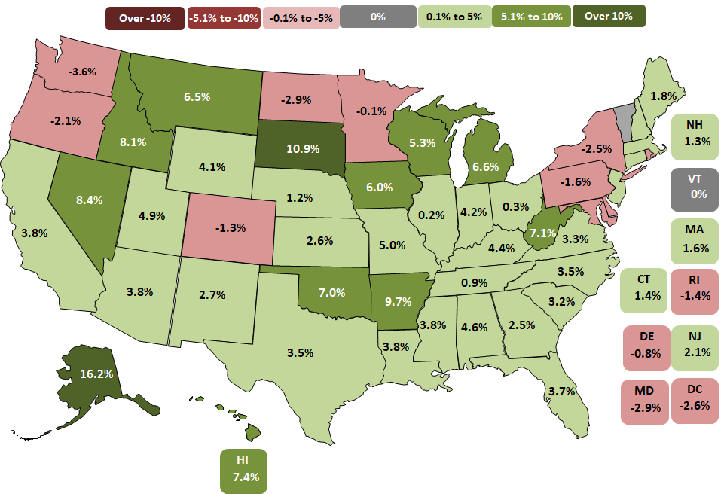
Construction employment change by state, Mar. 2023-Mar. 2024 (U.S.: 3.4%)
39 states up, 10 states & DC down, 1 state unchanged
Top 5
AK | 16.2%
SD | 10.9%
AR | 9.7%
NV | 8.4%
ID | 8.1%
Bottom 5
WA | -3.6%
ND | -2.9%
MD | -2.9%
DC | -2.6%
NY | -2.5%
Source: Bureau of Labor Statistics, state and area employment, www.bls.gov/sae
©2024 The Associated General Contractors of America, Inc.

Slide 4
Construction job openings & new hires
Job openings and hires, March 2001-March 2024, not seasonally adjusted
Source: Bureau of Labor Statistics, www.bls.gov/jlt, Job Openings & Labor Turnover Survey (JOLTS)
©2024 The Associated General Contractors of America, Inc.

Slide 5
Construction wage “premium” vs. total private sector
Excess of average hourly earnings (AHE) for production and nonsupervisory employees in construction vs. private sector
Annual premium, 2000-2019
Monthly premium, Jan. 2020-Apr. 2024
(seasonally adjusted)
2000- 2019 Average premium [21.5%]
% change in AHE Apr. 2023 – Apr. 2024:
Construction | 4.6%
Private | 4.0%
Sources: BLS, www.bls.gov/ces
©2024 The Associated General Contractors of America, Inc.

Slide 6
Construction materials & labor costs
Year-over-year change in producer price index (PPI) for nonresidential inputs and average hourly earnings (AHE) for production employees in construction, Feb. 2020 – Mar. 2024
PPI for nonresidential inputs
AHE for production employees in construction
% change since:
Mar. 2023
Feb. 2020
AHE*
4.9%
21%
PPI**
1.5%
39%
*Seasonally adjusted (SA)
**Not seasonally adjusted (BLS does not post SA data for this series)
Source: Bureau of Labor Statistics, PPI, www.bls.gov/ppi ; AHE, https://www.bls.gov/ces/
©2024 The Associated General Contractors of America, Inc.

Slide 7
Input costs have risen faster than bid prices since early 2020
Cumulative change in producer price index (PPI) for inputs and bid prices for nonresidential construction, Feb. 2020-Mar. 2024
% change to Mar. 2024 in PPI: | PPI for inputs: | Bid price PPI:
Feb. 2020 | 39% | 32%
Mar. 2023 | 1.5% | -0.8%
Feb. 2024 | 0.3% | 0.1%
Source: Bureau of Labor Statistics, www.bls.gov/ppi
©2024 The Associated General Contractors of America, Inc.

Slide 8
Cost squeeze on contractors can reappear suddenly
Difference between year-over-year change in materials costs vs. bid prices, Jan 2016-Mar 2024
Difference between year-over-year change in materials costs vs. bid prices, Jun 2020-Sep 2021
Sep 2020- May 2022
21 months
= period when change in input costs exceeded change in bid prices
Dec 2016- Dec 2018
25 months
Mar 2023-Mar 2024 change:
Input price PPI | 1.5%
Bid price PPI | -0.8%
Difference | 2.3%
2023
2024
Source: BLS, www.bls.gov/ppi, producer price indexes for inputs to new nonresidential construction and bid prices
©2023 The Associated General Contractors of America, Inc.

Slide 9
Some construction costs remain volatile
producer price indexes, 1 - & 12-mo. change (not seasonally adjusted)
March 2024 change from:
Feb. 2024 Mar. 2023
(1 month) (12 months)
Cement |  | 0% | 5.0%
Ready-mix concrete |  | 0.1% | 7.0%
Diesel fuel |  | -0.6% | -6.2%
Subcontractor price indexes, nonresidential building work
Roofing contractors |  | 0.0% | 3.7%
Plumbing contractors |  | -0.1% | 1.8%
​Electrical contractors |  | 0.0% | -5.1%
Concrete contractors |  | 0.2% | -0.8%
Source: BLS, producer price indexes, www.bls.gov/ppi
©2024 The Associated General Contractors of America, Inc.

Slide 10
Change in construction spending: March 2024 vs. March 2023
Year-over-year % change in current (not inflation-adjusted) dollars, seasonally adjusted
Source: Author, from U.S. Census Bureau, www.census.gov/constructionspending
©2024 The Associated General Contractors of America, Inc.

Slide 11
Change in construction spending: March 2024 vs. March 2023
current (not inflation-adjusted) dollars, seasonally adjusted
Total 10%: Private residential 4% (single-family 18%; multi 3%; improvements -10%); public residential 15%
Nonresidential 14% (private 11%, public 18%)
Nonresidential segments (in descending order of Mar. 2024 spending; combined new & renovation spending)
Mfg. 26% (computer/electronic 34%; chemical 10%; transportation equipment 39%; food/beverage/tobacco -23%)
Highway and street 20%
Power 13% (electric 15%; oil/gas fields & pipelines 0.1%)
Commercial 1% (warehouse -4%; retail 8%; farm 3%)
Education 17% (primary/secondary 16%; higher ed 19%)
Office (including data centers) 7%
Transportation 6% (air 13%; private rail/truck 4%; transit -17%)
Health care 10% (hospital 8%; medical building 13%; special care 13%)
Other: Sewage/waste 11%; Amuse/recreation 19%; Water supply 17%; Communication 4%; Lodging -0.5%; Conservation/development -6%
Source: Author, from U.S. Census Bureau, www.census.gov/constructionspending
©2024 The Associated General Contractors of America, Inc.

Slide 12
Medium-term outlook for construction
Economic recovery should continue but with sticky inflation & interest rates
Single-family homebuilding should continue recovering
Multifamily, warehouse, office: steep drops likely as vacancies and costs climb
Data center and manufacturing construction should remain hot
Infrastructure Investment & Jobs Act, “Chips” Act, Inflation Reduction Act will give major boost to infrastructure, manufacturing, and power construction. BUT
- money will be slow to turn into construction awards and spending
- Buy America, labor, environmental strings may tie up project starts for years
Materials costs, lead times: mostly better except electrical gear, some electronics
Labor availability has resumed being the #1 challenge for many contractors
Source: Author
©2024 The Associated General Contractors of America, Inc.

Slide 13
Population change by state, July 2022–July 2023
(U.S.: 0.49%)
Decrease
0-0.49%
0.5-0.99%
1.0-1.49%
1.5%+
0.4%
1.3%
Top 5
SC | 1.7%
FL | 1.6%
TX | 1.6%
ID | 1.3%
NC | 1.3%
0.9%
0.5%
-0.1%
0.6%
0.4%
NH 0.2%
0.3%
-0.5%
VT
0.05%
0.4%
1.0%
0.04%
-0.2%
0.5%
0.2%
-0.08%
MA
0.3%
1.1%
0.5%
-0.3%
0.2%
0.6%
0.4%
-0.2%
0.1%
0.3%
0.4%
CT 0.2%
RI 0.2%
0.3%
Bottom 5
NY | -0.5%
LA | -0.3%
HI | -0.3%
IL | -0.3%
WV | -0.2%
0.9%
1.3%
0.04%
0.9%
1.1%
DE 1.2%
NJ 0.3%
1.6%
0.7%
1.7%
0.03%
0.7%
1.1%
MD
0.3%
DC
1.2%
AK
0.02%
-0.3%
1.6%
HI -0.3%
Source: U.S. Census Bureau, Dec. 2023 population estimates, www.census.gov/popest
©2024 The Associated General Contractors of America, Inc.

Slide 14
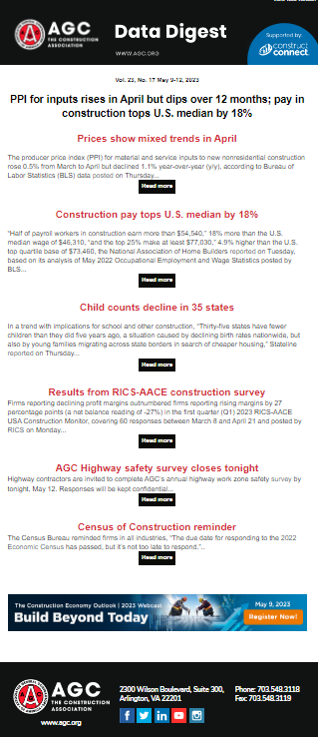
AGC economic resources
(email ken.simonson@agc.org)
Data DIGest: weekly email summary of construction economic news (subscribe: https://marketplace.agc.org/Store/ItemDetail?iProductCode=4401&OrderLineId=901649fd-c733-4103-93e0-a251778cd084)
Surveys, state and metro data, fact sheets: www.agc.org/learn/construction-data
Monthly press releases: construction spending; producer price indexes; national, state, metro employment with rankings: https://www.agc.org/newsroom
Construction impact model: https://www.agc.org/agc-construction-impact-model
ConsensusDocs Price Escalation Resource Center: https://www.consensusdocs.org/price-escalation-clause/
Source: Author
©2024 The Associated General Contractors of America, Inc.

